Slide 1
Wire-embedding 3D printer
Jacob Bayless
Mo Chen
Bing Dai

Slide 2
Outline
Introduction to the Replicating Rapid Prototyper (RepRap)
Project goals and motivation
RepRap Details
Our contribution:
Wire embedding module

Slide 3
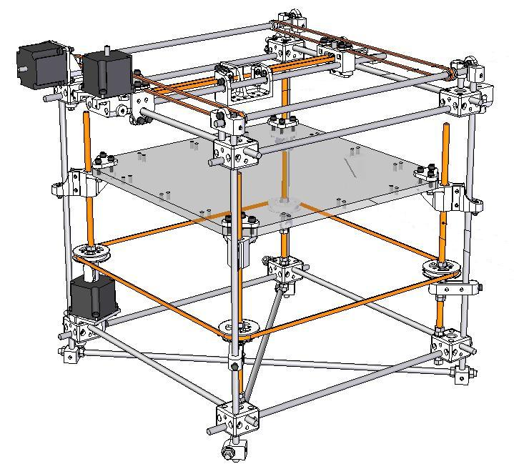
RepRap Specifications
0.5 mm resolution in the X&Y directions
0.1 mm resolution in the Z direction
Material: Biodegradable plastic

Slide 4
Why RepRap?
3D printing
Cost: $800 vs. >$15,000
Can print itself
Open source project

Slide 5
Project goals
To build a RepRap
To add 2D solid wire embedding capability to RepRap
To document the new design on the RepRap wiki according to open-source standards

Slide 6
Printed Model Life-Cycle
Solid Model
G-Code
Printed Part

Slide 7
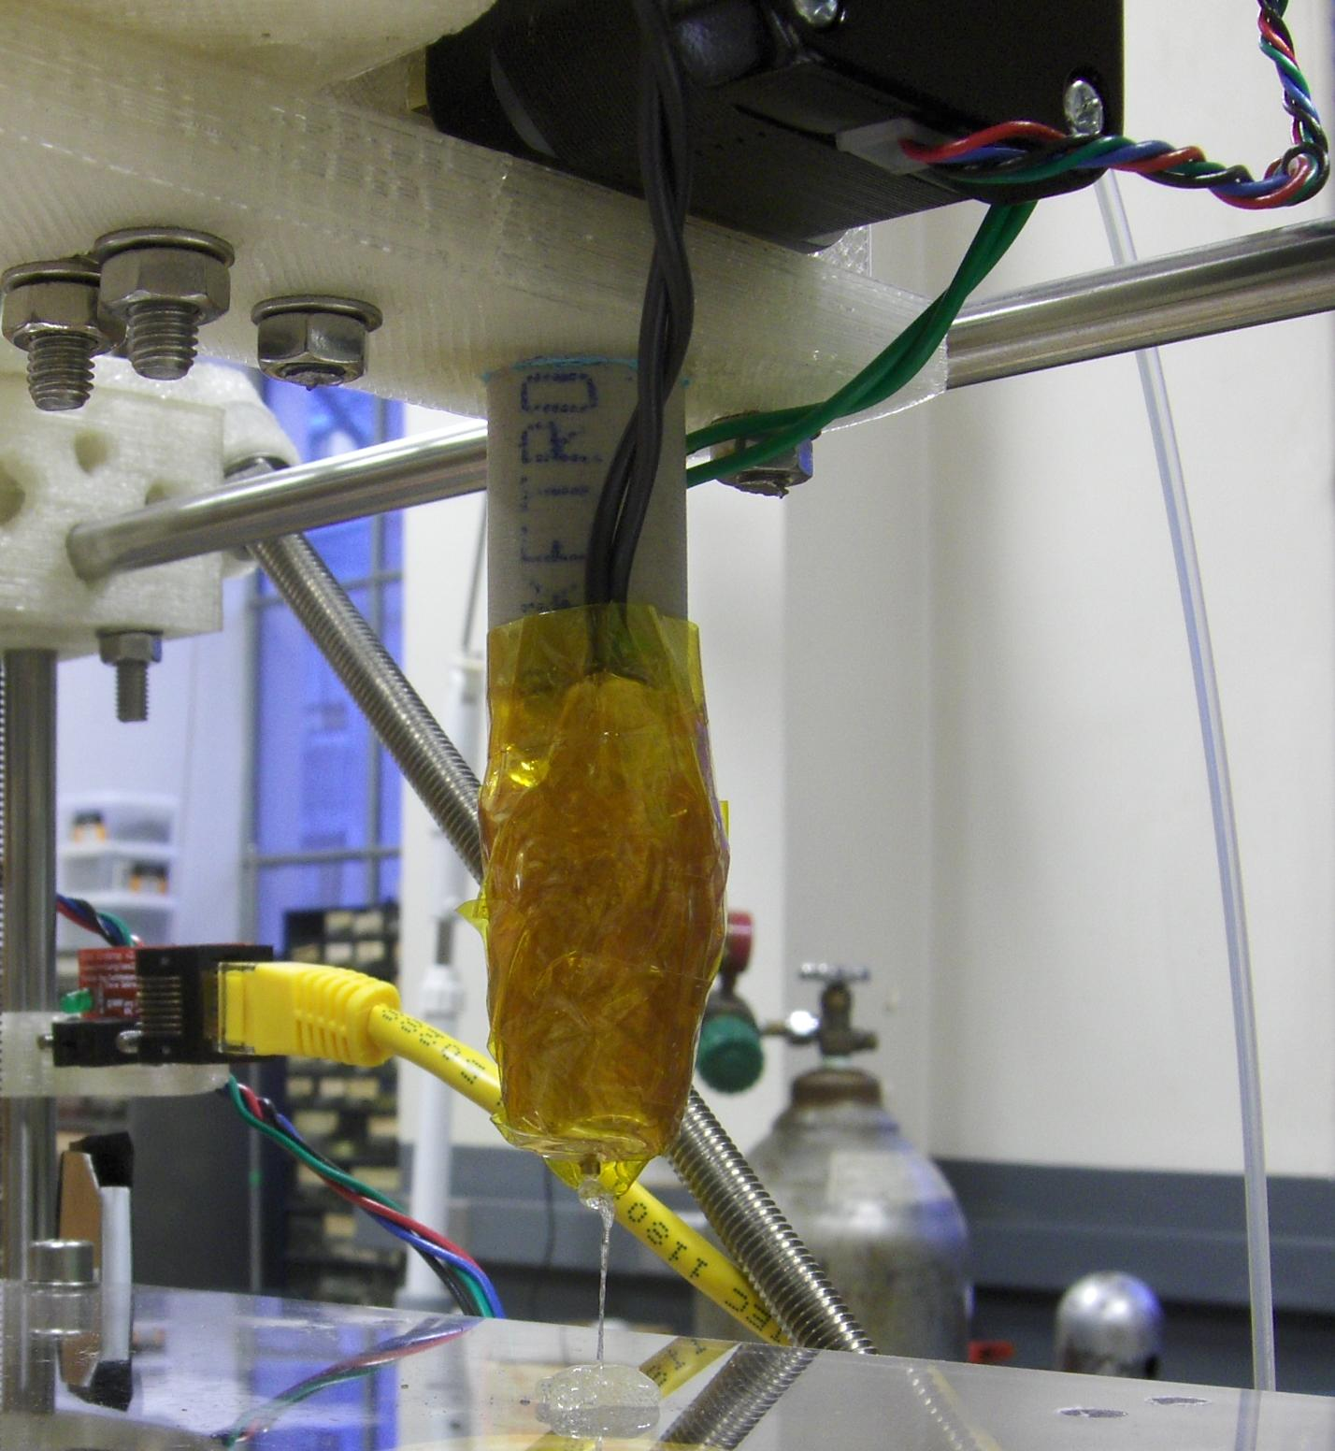
RepRap Plastic Extruder
Melts plastic filament and pushes it through a small nozzle
Plastic is squeezed between a motor shaft and a bearing

Slide 8
RepRap Mechanical Design
Each axis controlled by a stepper motor
Extruder moves in X-Y plane
The Z platform moves down after each layer

Slide 10
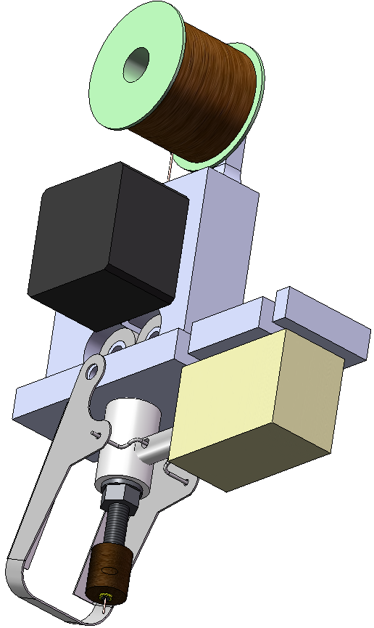
Wire Embedding Module
Tasks:
Feed wire
Bond wire to part
Cut wire

Slide 11
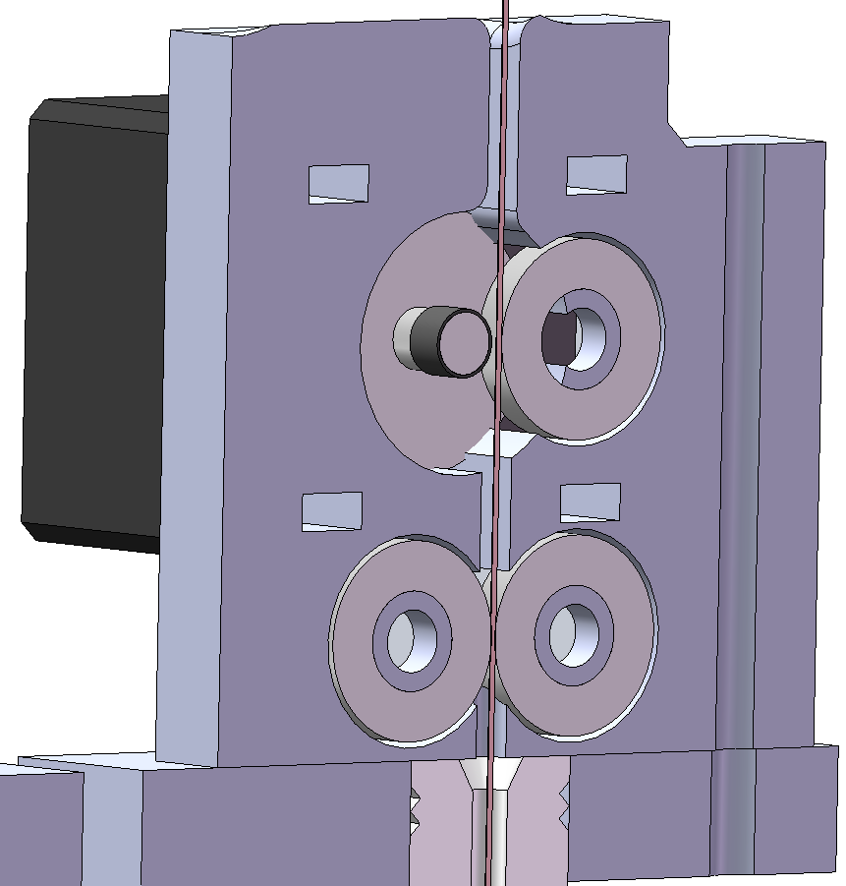
Feed Wire
Same method as plastic extruder
Pinch wire against motor shaft

Slide 12
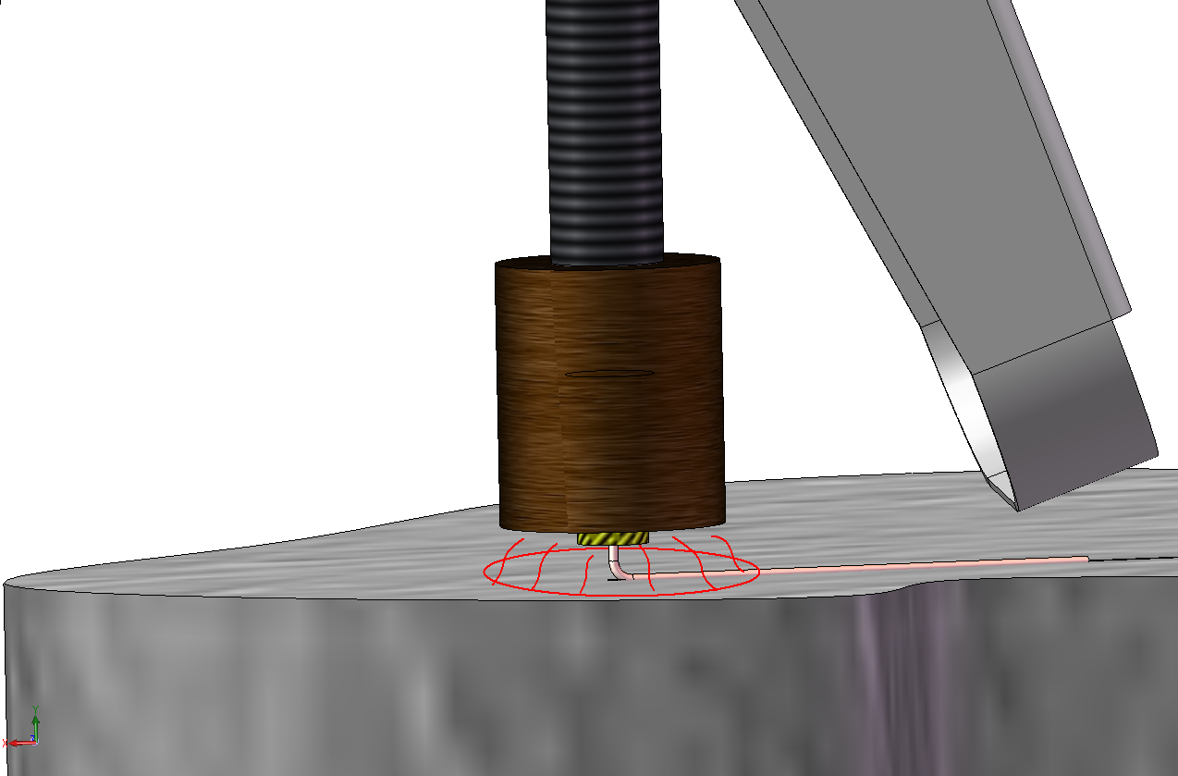
Bond wire to part
Create a “hot zone” on the plastic surface

Slide 13
Cutting wire

Slide 14
Wire Embedding Module Electronics
Off-the-shelf Arduino controller outputs:
2 high current switches
1 high current pulse-width modulation (PWM) output
2 H-bridges
2 Servo outputs
One controller for each print head

Slide 15
Special thanks to Wade!
Please visit us in Hennings 208

